Slide 1
Number system, Operations and Basic Logic Gates
Part 2
Course : CPEN6265010 Digital System
Effective Period : September 2025

Slide 2
Related LO
Learning Objectives
LO1: Analyze and Design Combinational Logic Circuits.

Slide 3
Outlines
Arithmetic Operations with Signed Numbers
Octal and Hexadecimal Numbers
Binary Coded Decimal (BCD)
Digital and Error Codes

Slide 4
Arithmetic Operations with Signed Numbers
Using the signed number notation with negative numbers in 2’s complement form simplifies addition and subtraction of signed numbers.
Rules for addition: Add the two signed numbers. Discard any final carries. The result is in signed form.
Examples:
00011110 = +30
00001111 = +15
00001110 = +14
11101111 = -17
11111111 = -1
11111000 = -8
00101101
= +45
11111101
= -3
1
11110111
= -9
Discard carry

Slide 5
Arithmetic Operations with Signed Numbers
Note that if the number of bits required for the answer is exceeded, overflow will occur. This occurs only if both numbers have the same sign. The overflow will be indicated by an incorrect sign bit.
Two examples are:
01000000 = +128
01000001 = +129
10000001 = -127
10000001 = -127
10000001
= -126
Discard carry
100000010
= +2
Wrong! The answer is incorrect and the sign bit has changed.

Slide 6
Arithmetic Operations with Signed Numbers
Rules for subtraction: 2’s complement the subtrahend and add the numbers. Discard any final carries. The result is in signed form.
Repeat the examples done previously, but subtract:
00011110
00001111
(+30)
–(+15)
00001110
11101111
11111111
11111000
(+14)
–(-17)
(-1)
–(-8)
-
-
-
2’s complement subtrahend and add:
00011110 = +30
11110001 = -15
00001110 = +14
00010001 = +17
11111111 = -1
00001000 = +8
1
00001111
= +15
00011111
= +31
1
00000111
= +7
Discard carry
Discard carry

Slide 7
Octal Numbers
Decimal
Hexadecimal
Binary
0 1 2 3 4 5 6 7 8 9 10 11 12 13 1415
0 1 2 3 4 5 6 7 8 9 A B C D E F
0000 0001 0010 0011 0100 0101 0110 0111 1000 1001 1010 1011 1100 1101 1110 1111
Octal uses eight characters the numbers 0 through 7 to represent numbers. There is no 8 or 9 character in octal.
Binary number can easily be converted to octal by grouping bits 3 at a time and writing the equivalent octal character for each group.
Example
Express 1 001 011 000 001 110₂ in octal:
Solution
Group the binary number by 3-bits starting from the right. Thus, 113016₈

Slide 8
Octal Numbers
Decimal
Hexadecimal
Binary
0 1 2 3 4 5 6 7 8 9 10 11 12 13 1415
0 1 2 3 4 5 6 7 8 9 A B C D E F
0000 0001 0010 0011 0100 0101 0110 0111 1000 1001 1010 1011 1100 1101 1110 1111
Octal is also a weighted number system. The column weights are powers of 8, which increase from right to left.
{
8³ 8² 8¹ 8⁰
.
Column weights
512 64 8 1
.
Example
Express 3702₈ in decimal.
Solution
Start by writing the column weights:
512 64 8 1
3 7 0 2₈
3(512) + 7(64) +0(8) +2(1) =
1986₁₀

Slide 9
Hexadecimal Numbers
Decimal
Hexadecimal
Binary
0 1 2 3 4 5 6 7 8 9 10 11 12 13 1415
0 1 2 3 4 5 6 7 8 9 A B C D E F
0000 0001 0010 0011 0100 0101 0110 0111 1000 1001 1010 1011 1100 1101 1110 1111
Hexadecimal uses sixteen characters to represent numbers: the numbers 0 through 9 and the alphabetic characters A through F.
Large binary number can easily be converted to hexadecimal by grouping bits 4 at a time and writing the equivalent hexadecimal character.
Example
Express 1001 0110 0000 1110₂ in hexadecimal:
Solution
Group the binary number by 4-bits starting from the right. Thus, 960E

Slide 10
Hexadecimal Numbers
Decimal
Hexadecimal
Binary
0 1 2 3 4 5 6 7 8 9 10 11 12 13 1415
0 1 2 3 4 5 6 7 8 9 A B C D E F
0000 0001 0010 0011 0100 0101 0110 0111 1000 1001 1010 1011 1100 1101 1110 1111
Hexadecimal is a weighted number system. The column weights are powers of 16, which increase from right to left.
{
16³ 16² 16¹ 16⁰
.
Column weights
4096 256 16 1
.
Example
Express 1A2F₁₆ in decimal.
Solution
Start by writing the column weights:
4096 256 16 1
1 A 2 F₁₆
1(4096) + 10(256) +2(16) +15(1) =
6703₁₀

Slide 11
Binary Coded Decimal (BCD)
Decimal
Binary
BCD
0 1 2 3 4 5 6 7 8 9 10 11 12 13 1415
0000 0001 0010 0011 0100 0101 0110 0111 1000 1001 1010 1011 1100 1101 1110 1111
0000 0001 0010 0011 0100 0101 0110 0111 1000 1001 0000 0001 0010 0011 0100 0101
Binary coded decimal (BCD) is a weighted code that is commonly used in digital systems when it is necessary to show decimal numbers such as in clock displays.
The table illustrates the difference between straight binary and BCD. BCD represents each decimal digit with a 4-bit code. Notice that the codes 1010 through 1111 are not used in BCD.
0001 0001 0001 0001 0001 0001

Slide 12
Binary Coded Decimal (BCD)
You can think of BCD in terms of column weights in groups of four bits. For an 8-bit BCD number, the column weights are: 80 40 20 10 8 4 2 1.
Question:
What are the column weights for the BCD number 1000 0011 0101 1001?
Answer:
8000 4000 2000 1000 800 400 200 100 80 40 20 10 8 4 2 1
Note that you could add the column weights where there is a 1 to obtain the decimal number. For this case:
8000 + 200 +100 + 40 + 10 + 8 +1 = 8359₁₀

Slide 13
Digital Codes
Decimal
Binary
Gray code
0 1 2 3 4 5 6 7 8 9 10 11 12 13 1415
0000 0001 0010 0011 0100 0101 0110 0111 1000 1001 1010 1011 1100 1101 1110 1111
0000 0001 0011 0010 0110 0111 0101 0100 1100 1101 1111 1110 1010 1011 1001 1000
Gray code is an unweighted code that has a single bit change between one code word and the next in a sequence. Gray code is used to avoid problems in systems where an error can occur if more than one bit changes at a time.

Slide 14
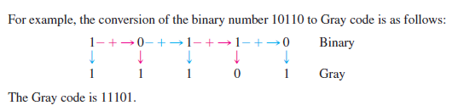
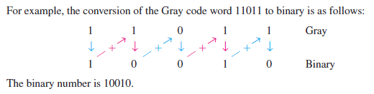
Digital Codes

Slide 15
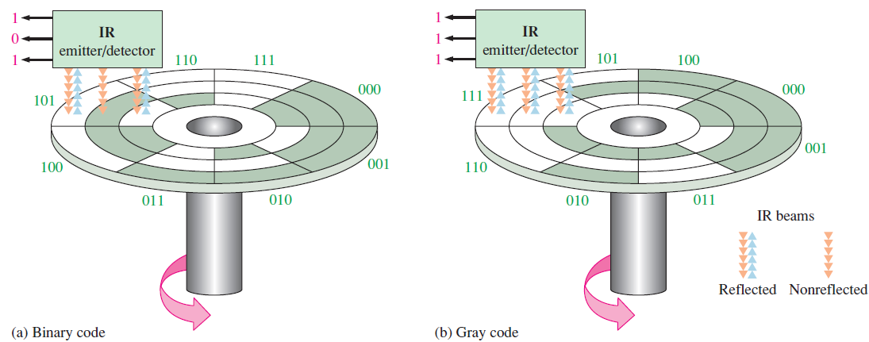
Digital Codes
A shaft encoder is a typical application of gray codes. Three IR emitter/detectors are used to encode the position of the shaft. The encoder on the left uses binary and can have three bits change together, creating a potential error. The encoder on the right uses gray code and only 1-bit changes, eliminating potential errors (transitional error).

Slide 16
Digital Codes
ASCII is a code for alphanumeric characters and control characters. In its original form, ASCII encoded 128 characters and symbols using 7-bits. The first 32 characters are control characters, that are based on obsolete teletype requirements, so these characters are generally assigned to other functions in modern usage.
In 1981, IBM introduced extended ASCII, which is an 8-bit code and increased the character set to 256. Other extended sets (such as Unicode) have been introduced to handle characters in languages other than English.

Slide 17
Error Codes
The parity method is a method of error detection for simple transmission errors involving one bit (or an odd number of bits). A parity bit is an “extra” bit attached to a group of bits to force the number of 1’s to be either even (even parity) or odd (odd parity).
The ASCII character for “a” is 1100001 and for “A” is 1000001. What is the correct bit to append to make both of these have odd parity?
Example
The ASCII “a” has an odd number of bits that are equal to 1; therefore the parity bit is 0. The ASCII “A” has an even number of bits that are equal to 1; therefore the parity bit is 1.
Solution

Slide 18
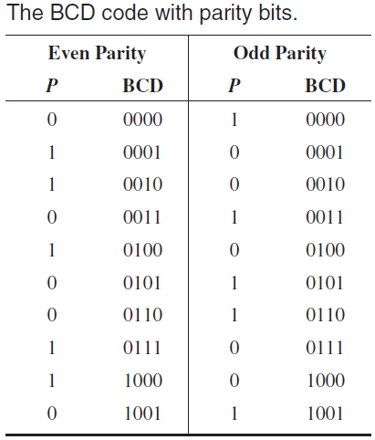
Error Codes

Slide 19
Exercise
What is the weight of 7 in each of the following decimal numbers?
(a) 1947 (b) 1799 (c) 1979
Express each of the following decimal numbers as a power of ten:
(a) 1000 (b) 10000000 (c) 1000000000
Convert each decimal fraction to binary using the sum-of-weights method:
(a) 0.26 (b) 0.762 (c) 0.0975
How is zero represented in 2’s complement form?
Perform each addition in the 2’s complement form:
  (a) 00010110 + 00110011 (b) 01110000 + 10101111
Convert each binary number to hexadecimal:
(a) 1111 (b) 1011 (c) 11111
Convert each pair of decimal numbers to BCD, and add as indicated:
(a) 28 + 23 (b) 65 + 58 (c) 113 + 101

Slide 20
References
Null, Linda (2024). "The essentials of computer organization and architecture". 6th edition. Jones & Bartlett Learning, Burlington, Massachusetts. ISBN: 9781284259438..
Thomas L. Floyd. (2014). “Digital Fundamentals”. 11th Edition. Prentice Hall. New Jersey. ISBN: 978-0132737968.
Number System tutorial: https://ryanstutorials.net/binary-tutorial/
Binary Numbers Explained – Beginners Guide: http://www.steves-internet-guide.com/binary-numbers-explained/

Slide 21
References
Digital Logic Gates: https://www.electronics-tutorials.ws/logic/logic_1.html
CMOS and TTL Comparisons: https://circuitdigest.com/article/comparision-between-cmos-vs-ttl-logic-which-is-better-and-why

